Slide 1


CS6220 : Data Mining Techniques
Data Mining to Analyze and Prevent Vehicular Crashes
Notes:
In the last two or more years of being in this city, it feels like accidents are something that everyone has become accustomed to. And it feels like the frequency of these accidents is increasing but there have been no changes to public safety guidelines to reduce these occurrences.
This project is an attempt to analyse vehicle crashes with an aim to understand the primary factors that cause traffic accidents. With these factors isolated, we can attempt to integrate them into our daily lives through possibly forming improved traffic regulations, road infrastructure, better EMS routes and even raising public awareness.

Slide 2






Data Mining to Analyze and Prevent Vehicular Crashes
Presented to Prof. Arunagiri
Bhaskar Vemuri
Jean
Nei
Sushmita Chaudhary
Dhruv Shetty
Sameer Desai
Notes:
This project is a result of team effort of the following members:
…….
**Transition: So, without further ado, let’s get started.

Slide 3
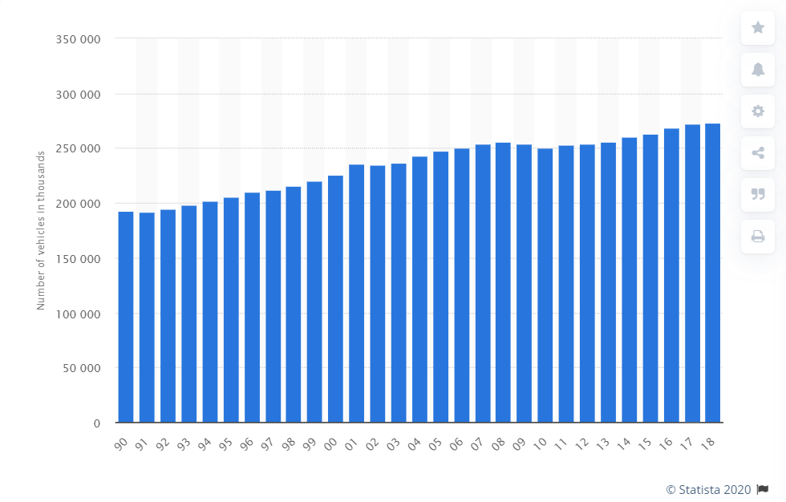
Vehicle Registration Statistics
Number of vehicles registered by year in the US
Notes:
Sushmita: Each year more and more people in the United States are getting behind the wheel.
If we look at the data for annual registrations for the past 30 years, numbers have reached up to a staggering 276 million - that’s about 85% of the population of the country. And this is just upto the year 2018. What does this mean for when people are on the road?

Slide 4
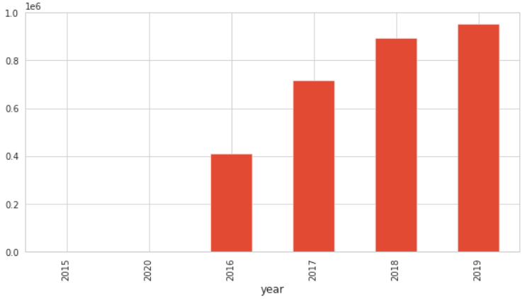
Traffic Accidents Trend
Number of accidents per year
Number of accidents (millions)
Notes:
Sushmita: As traffic density on roads increases, the probability of getting into an accident increases as well. This is an instinctual conclusion to draw, and the figure in front of you shows exactly that. Recent years have shown that the occurrence of accidents has almost doubled since 2016. The annual fatalities caused from these accidents are more than any other cause of death.

Slide 5
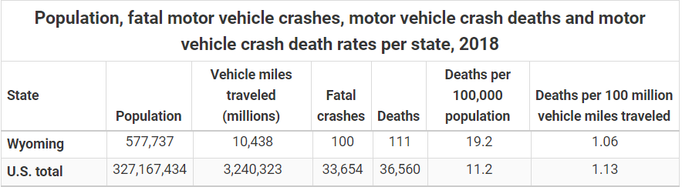
Road traffic accidents are among the leading causes of death and injury worldwide.
Reducing traffic accidents is an important public safety challenge.
Dataset : Country wise accident dataset covers all 49 states.
Around 3 million records and has 49 attributes.
Apply clustering techniques on various attributes like severity, city and chose k- value using SSQ and Gap statistic techniques.
Data Preprocessing
Notes:
Sushmita: In 2018 alone, there were 36,560 deaths caused by motor accidents. Deaths on such a scale warrant for more than just keeping a record of accidents. The dataset we use is quite large, with about 49 attributes. These attributes describe accidents in quite detail and may potentially help us gain relevant information.
(4E) *< -- Que to next person to start visualizations*
** include information about dataset. ** ??? ( in this slide vs next)

Slide 6
Data Description
Primary
Time
Location
Weather Conditions
Zone/Area of accident
ID
TMC
Severity
Description
Distance
Start_Time
End_Time
Time Zone
Sunrise Sunset
Astronomical Twilight
Civil Twilight
Nautical Twilight
Weather Timestamp
Str_Lat/End_Lat
Str_Long/End_Long
Number
Zipcode
Street
Side
City
County
State
Temperature
Wind Chill
Humidity
Pressure
Visibility
Wind Direction
Wind Speed
Precipitation
Weather Condition
Amenity
Bump
Crossing
Give Way
Junction
No_Exit
Railway
Roundabout
Station
Stop
Traffic Calming Traffic Signal
Turning Loop
** Source:Moosavi, Sobhan, Mohammad Hossein Samavatian, Srinivasan Parthasarathy, and Rajiv Ramnath. “A Countrywide Traffic Accident Dataset.”, arXiv preprint arXiv:1906.05409 (2019).
Notes:
We sourced our dataset from an Ohio State University study on Accident Risk Prediction. This dataset has around 49 attributes of which 44 are relevant to us. Because of the high number of attributes, it made sense to club these into groups with similar characteristics. As you can see from the slide, attributes are divided into 5 groups. Primary attributes are the key identifiers, Time, location and weather provide the respective prevailing conditions at the time of the accidents.
Zone or areas of accidents specifies which one of the listed traffic regulatory entities the vehicle was near at the time of crash.
So, what does analyzing a dataset of 3 million records tell us?

Slide 7
VISUALIZATIONS
We have performed different visualizations on the dataset:
Bar Graph
Correlation HeatMap
Word Cloud
Joint Plot
Time Plot
Pie Chart
Notes:
Sameer: For any data analysis understanding data is very important .We need data visualization because visual summary of information makes it easier to identify the patterns and trends rather than looking through thousands of rows on a spreadsheet . It's the way human brain works We performed different type of visualizations namely - Bar Graph, Correlation Heat Map, Word Cloud, Joint Plot,Time Plot and pie chart. We used standard Python libraries like Seaborn, Matplotlib, GGplot to visualize the dataset .

Slide 8
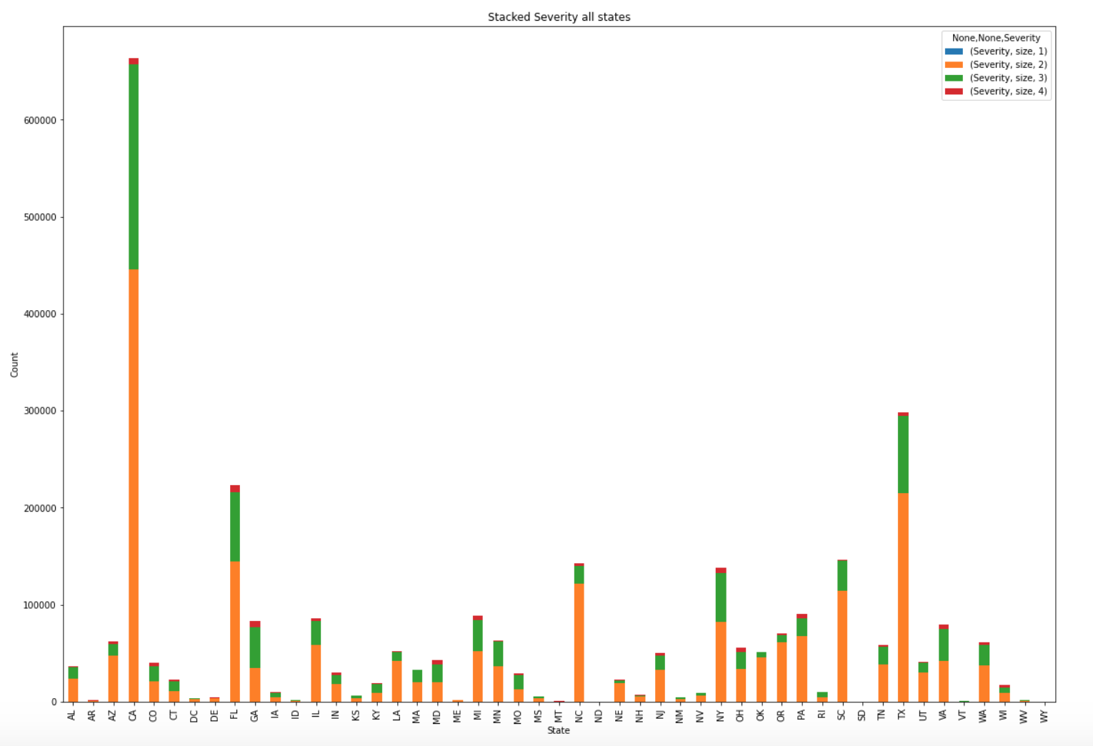
Number of accidents by state with severity
Number of accidents in each state along with severity.
California - Largest and most populous state has most number of accidents.
Wyoming the least populous state has least number of accidents.
Most accidents in all the states are with severity 2 and above
Notes:
Sameer: Firstly , we plotted a bar graph for numbers of accidents in each state along with with severity. This was one of the simplest yet most effective data visualisation we performed.
It was not surprising to to find out California, the largest and most populous state in USA had most number of accidents with most of the accidents followed by Texas and Florida .On the other hand it Wyoming , the least populous state had the least number of accidents.
It is clear that number of accidents was directly proportional to the population .
Also it was interesting to note that most accidents caused very little impact to the traffic. The severity was 1 or 2.
Jean added this but this was what I was thinking you can mention:
Looking at the figure above you can see the top states with the most accidents are California, Texas and Florida respectively.
The states with the least number of accidents are Wyoming, North Dakota, and South Dakota.

Slide 9
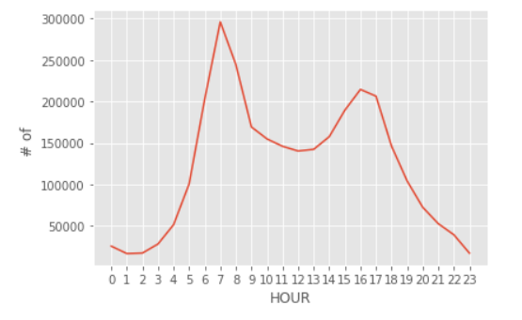
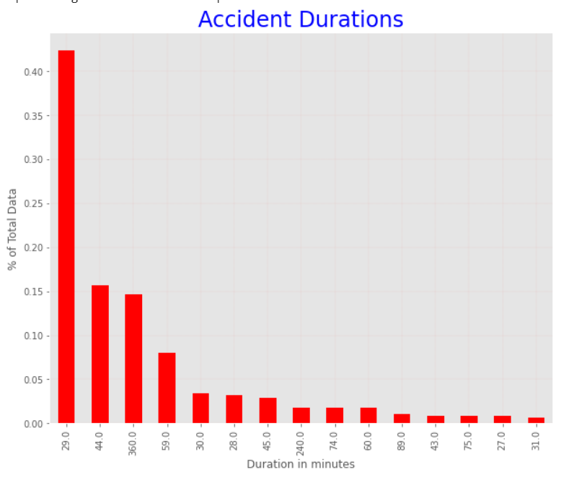
ACCIDENTS vs TIME
Most accidents happen during peak travel time .
The average accident duration is 29 minutes for more than 40 percent of accidents
During the past three years , most accidents occurred during the months of November - December.
Notes:
-- Accidents per hour (in 24 hours) and average duration of an accident
Sameer : Time was another dimension available to us in the dataset and we tried to exploit this to understand this dataset better.
The first plot on the top shows time of the day where most of accidents occured. And you guessed it right. Its peak commuting hours in the morning and afternoon. Most of the accidents took place during 6am and 8am in the morning and 4pm to 6pm in the evening.
The plot on the bottom shows the duration of accidents and it can be seen that for more than half of the accidents the duration is around 29mins.

Slide 10
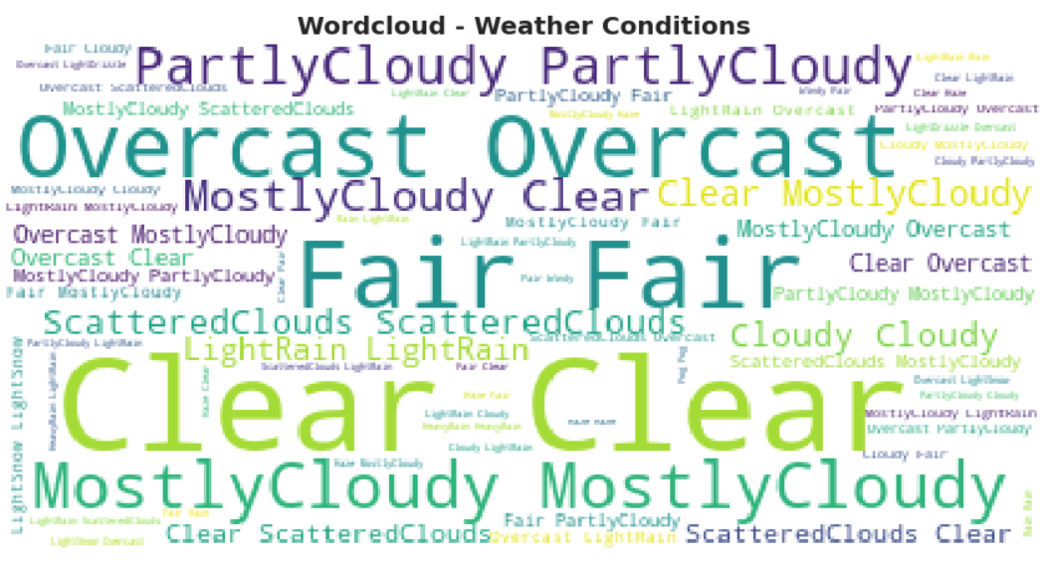
Word Cloud on Weather conditions
Word Cloud is a popular infographic which depicts the frequency of words in the dataset.
Most frequently occuring words : Clear, Overcast,Fair and Mostly cloudy
808171 : Most accidents when weather condition is clear
34315 : least number of accidents when its hazy.
Notes:
Sameer
Weather is one of the key feature of the dataset and would give us better understanding of occurrence of accidents . It was all over the news papers when Tesla autopilot successfully went through a storm in the night and that motivated us to keenly analyze this aspect of weather in the dataset.
Word cloud is one of the most popular infographic which depicts the frequency of occurrence of words in the dataset.
Bolder the word implies higher the frequency of their occurences . As you can see from the word cloud the words Clear, Mostly Cloudy and Overcast appear to be bolder than others. This indicates most of the accdients took place during these weather conditions. On the other hand, very few accidents took place when the weather was hazy. You can barely see that word in the plot.
Hey Sameer! Put in some text (bullet points) on your slides next to the images. No space :(

Slide 11
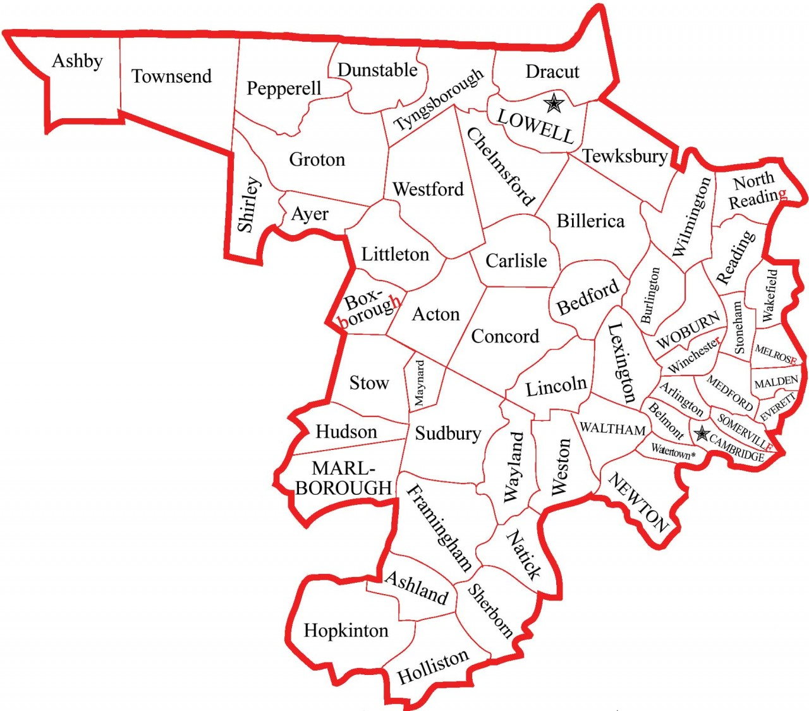
Association Rules Overview
Massachusetts Middlesex county
~1.6 million people the largest county in MA
Support threshold used – 2%
Confidence threshold used – 50%
Attributes selected for analysis
Weather
Point of interest types
Period of the day (day or night)
Notes:
Jean:
Since our dataset contained so much data we wanted to focus on an individual state in order to investigate correlations. We chose MA for a couple of reasons
We live in MA
Had a good sample size and we were able to further segment it by counties
We chose to focus on Middlesex county because it is the largest county in MA (https://www.massachusetts-demographics.com/counties_by_population)
Some of the popular areas in this county includes Somerville, Cambridge, Malden, and Medford
We decided to do some preprocessing on the data and focus on weather, point of interests and period of day, we felt that these attributes were very telling and could provide us some interesting data
We used a support threshold of 2% and a confidence threshold of 50%

Slide 12
Association Rules Results Overview
X | Severity | Confidence | Support
+Crossing, Day | 2 | 0.85 | 0.041
Scattered Clouds, Day | 2 | 0.595 | 0.048
+Crossing, +Traffic_Signal | 2 | 0.864 | 0.025
Day, Light Rain | 2 | 0.62 | 0.036
Cloudy | 2 | 0.59 | 0.021
+Crossing, Day, +Traffic_Signal | 2 | 0.865 | 0.021
+Junction, Night | 3 | 0.653 | 0.021
+Junction | 3 | 0.622 | 0.089
+Junction, Clear | 3 | 0.596 | 0.024
+Junction, Day | 3 | 0.613 | 0.069
Notes:
Jean:
We can see there is a correlation between the severity of the accident and where the accidents occured.
For example we can see when there is a junction, the severity of the accidents tends to be higher, i.e. 3, than it is when a junction is not present, i.e. 2.
In addition to this we can see if there is a traffic signal present the severity tends to be lower.
These results make sense because traffic lights are designed to control the flow of traffic and with the presence of them it makes sense that traffic is not significantly hampered, whereas at junctions its difficult to control the flow of traffic.
What is interesting about this is that there is a very high confidence between traffic signals and cross walks and the severity, which correlates to a severity of 2.

Slide 13
Modelling
Six different approaches to explore the dataset :
Neural Networks
Logistic Regression
K- Nearest Neighbors
Decision Trees
Random Forest
Gaussian Naive Bayes
Notes:
Bhaskar:
The process of training a Machine Learning model involves providing the learning algorithm with the training data to learn from. The term Machine Learning model refers to the model artifact that is created by the training process.
The training data must contain the correct answer, which is known as a target or target attribute. The learning algorithm finds patterns in the training data that map the input data attributes to the target or the answer that you want to predict. It outputs a model that captures these patterns.
As models are exposed to new data, they are able to independently adapt. They learn from previous computations to produce reliable, repeatable decisions and results.
We have defined 6 different models on our dataset starting with Neural Networks.

Slide 14
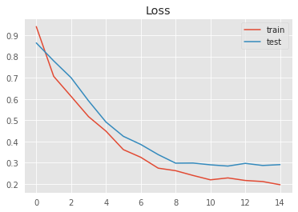
Neural Networks
Model to classify the severity of the accident based on the natural language description of the accident.
Tokenized: used most frequent words.
LSTM Recurrent Neural Network with Softmax activation, 15 epochs
Accuracy: 90%
Notes:
Bhaskar:
The first model we designed was to classify the severity based upon the natural language description of the accident using Sequence Classification.
Sequence classification is a predictive modeling problem where you have some sequence of inputs over space or time and the task is to predict a category for the sequence.
What makes this problem difficult is that the sequences can vary in length, be comprised of a very large vocabulary of input symbols and may require the model to learn the long-term context or dependencies between symbols in the input sequence.
In this model, we have used Long Short-Term Memory or LSTM networks which are a modified version of recurrent neural networks and makes it easier to remember past data in the memory.
The activation function we used was Softmax with 15 epochs. Our model has an accuracy of 90% while classifying the severity based on the description.
In the future, if there is an accident reported at any place, using this model, the criticality of the accident could be predicted and relevant action could be taken by informing the police and health authorities.

Slide 15
Logistic Regression
SkLearn Logistic Regression classifier with liblinear solver.
Maximum iterations - 100
Accuracy score of 76.8 percent for Dallas County and 83.8 for Middlesex county
Dallas county has more number of accidents
Distribution of data in the feature space might be different for both of them.
Notes:
Bhaskar:
The next model we created was a logistic regression classifier with liblinear solver.
The purpose of this model is to predict the severity of the accident using a set of features based upon the geographic location and weather conditions.
We ran this model over two distinct datasets - Middlesex and Dallas counties. Dallas has three times more number of accidents compared to Middlesex.
In order to test the model, we have randomly split each of our dataset into training and test data samples.
We observed accuracy scores of around 76% and 83% for Dallas and Middlesex counties respectively.
We could see that the distribution of data for Middlesex is linear compared to Dallas which is normally distributed.

Slide 16
K-Nearest Neighbors
SKLearn KNeighbors Classifier
Number of neighbors : 6
Accuray score in Dallas : 68.3 % ,Middlesex : 58.3%
KNN is a non parametric model
Logistic Regression outperforms K-Nearest Neighbors
Notes:
Bhaskar:
Following on, we used the same test and train data to validate upon the K-nearest Neighbors model; with 6 neighbors.
The KNN algorithm assumes that similar things exist in close proximity.
Using this model, the accuracy score on the Dallas county data is 68.3% while it is 58.3% on Middlesex data. We could observe that Logistic regression performs better compared to KNN on both the datasets.

Slide 17
Decision Trees
SKLearn Decision Tree Classifier using both Gini and Entropy criterion.
Maximum depth of Tree : 8
Entropy Score : Dallas - 79.9 % , Middlesex 78.1%
Gini Criterion : Dallas - 79.5 % , Middlesex 78.2%
Decision Tree classifier performs similarly on both the dataset
Notes:
Bhaskar:
We performed our analysis on the Decision Tree classifier as well to observe how this model would work.
Decision Tree classifier is a supervised learning technique where the data is continuously split according to a certain parameter.
We have set the maximum depth of the tree as 8 on both Dallas and Middlesex county datasets and observed that there is not much of variance in the accuracy scores using both Gini impurity and Entropy.

Slide 18
Random Forest
Meta estimator that fits the number of decision Trees.
Accuracy score : 85.7 for Dallas County with number of Trees in the forest 100
20 Important features importance factor > 0.03.
Running random forest again on this improved the performance by 4 %
Similar analysis for Middlesex county resulted in the accuracy score of 89.8%
Notes:
The next classification algo we worked was Random forest.
Random forests or random decision forests are an ensemble learning method for classification, regression .
This classifier is an extension to the decision tree classifier. Instead of building single tree, random forest classifier builds multiple decision trees by randomly selecting features and building trees. The outcome is the highest voted decision.
We observed an accuarcy score of 85.7 pecent for the dallas county and accuracy score of 89.4 for middlesex county.
We experimented further by selecting only important features.
Featuers with importance factor greater thn 0.03 . WE had 20 such feautre.
This improved the accuracy score by 4percent which implied that some features are very critical in predicting the accidents .
We experimented further by by selecting only those features which have an importance factor greater than 0.03 This improved the accuracy score by 4%
found the top 20 important features and selected those which have an importance factor greater than 0.03. By running the Random forest classifier again only based on these important features, the accuracy improved by 4% - with a score of 90%.

Slide 19
Gaussian Naïve Bayes
Sklearn Gaussian Naïve Bayes classifier used with a variable smoothing factor of 1
Assumes that all the features are following the Gaussian or Normal distribution
Key assumption made is that all the variables (features) are independent (not correlated) of each other
For Dallas county, we observe an accuracy score of 62%
For Middlesex county, we observe an accuracy score of about 56%.

Slide 20
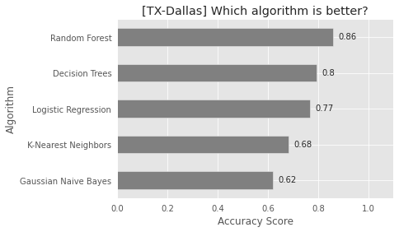
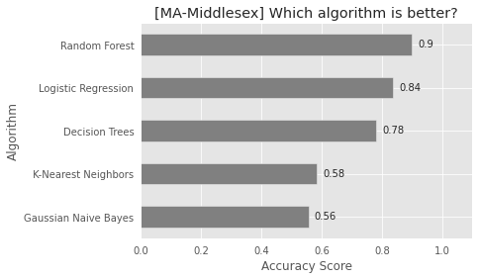
Results

Slide 21
Road Ahead
Run the algorithms on more counties in multiple states to improve quality of inferences
Apply Deep Learning Techniques to the dataset
Try the application of the analysis by moulding the 4 E’s (Enforcement, Education, Engineering, EMS)
More comprehensive analysis to shape new traffic regulations.
Propose road signs placements by analyzing the location of accidents to find common danger spots.

Slide 22
Conclusion
We observe 10 attributes that primarily impact the severity of accidents
Most of these accidents occur in the most ideal conditions - clear weather and daytime hours.
The chances of a motor accident occurring at a traffic junction in southern states is much higher
One proposal could be to elongate the islands at 4 way crossings by a small measure that would enforce cars to slow down before turning.
This dataset has further potential to have an impact on reduction in vehicle accidents through various means.

Slide 24
THANK YOU

